Slide 1
Basic SQL
Week 4

Slide 2
Structured Query Language (SQL)
SQL is structured Query Language which is a computer language for storing, manipulating and retrieving data stored in relational database.
SQL is the standard language for Relation Database System. All relational database management systems like MySQL, MS Access, Oracle, Sybase, Informix, postgres and SQL Server uses SQL as standard database language.

Slide 3
Why do we need SQL?
Allow users to access data in relational database management systems.
Allow users to describe the data.
Allow users to define the data in database and manipulate that data.
Allow users to create and drop databases and tables.
Allow users to create view, stored procedure, functions in a database.
Allow users to set permissions on tables, procedures, and views

Slide 4
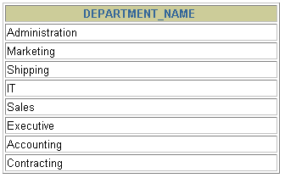
Communicating with the RDBMS
SQL statement is entered.
Statement is sent to Oracle Server.
SELECT department_name
FROM departments;
Oracle
server

Slide 5
SQL Processing Steps
SQL Query
Query Language Processor
Parser + Optimization
DBMS Engine
File Manager + Transaction Manger
Physical Database

Slide 6
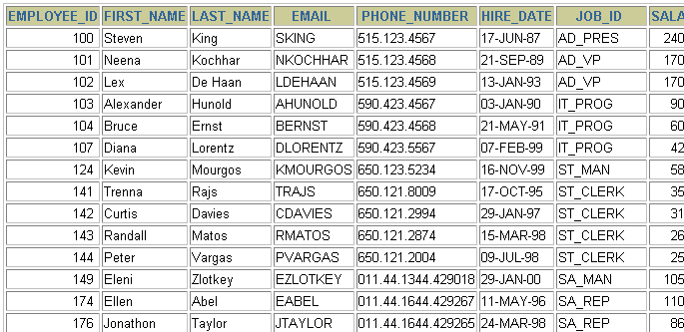
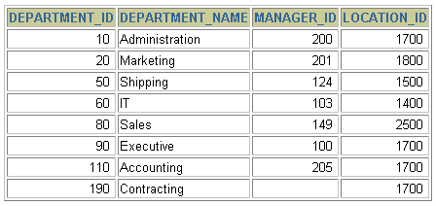
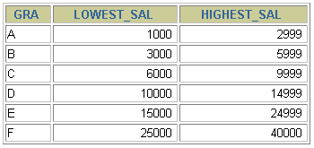
Tables used in this course
EMPLOYEES
DEPARTMENTS
JOB_GRADES

Slide 7
SQL Statements
Data manipulation language (DML)
Data definition language (DDL)
Transaction control language (TCL)
Data control language (DCL)

Slide 8
The CREATE TABLE Statement
You must have:
CREATE TABLE privilege
You specify:
Table name
Column name, data type, size and constraint if any
CREATE TABLE [schema.]table
(column datatype [DEFAULT expr][, ...])
Notes:
The CREATE TABLE Statement
Create tables to store data by executing the SQL CREATE TABLE statement. This statement is one of the data definition language (DDL) statements, that are covered in subsequent lessons. DDL statements are a subset of SQL statements used to create, modify, or remove Oracle9i database structures. These statements have an immediate effect on the database, and they also record information in the data dictionary.
To create a table, a user must have the CREATE TABLE privilege and a storage area in which to create objects. The database administrator uses data control language (DCL) statements, which are covered in a later lesson, to grant privileges to users.
In the syntax:
schema is the same as the owner’s name
table is the name of the table
DEFAULT expr specifies a default value if a value is omitted in the INSERT statement
column is the name of the column
datatype is the column’s data type and length
Instructor Note
Please read the Instructor note on page 9-37

Slide 9

Creating Tables
Dept(deptno:number, dname:text(14), loc:text(13))
Confirm table creation.
CREATE TABLE dept (deptno NUMBER(2),
dname VARCHAR2(14),
loc VARCHAR2(13));
Table created.
DESCRIBE dept
Notes:
Creating Tables
The example on the slide creates the DEPT table, with three columns: DEPTNO, DNAME, and LOC. It further confirms the creation of the table by issuing the DESCRIBE command.
Since creating a table is a DDL statement, an automatic commit takes place when this statement is executed.
Instructor Note
Explain that additional syntax for CREATE TABLE could include constraints and so on. For more information on the CREATE TABLE syntax, refer to: Oracle9i SQL Reference, “CREATE TABLE. ”

Slide 10
Dropping a Table
All data and structure in the table is deleted.
Any pending transactions are committed.
All indexes are dropped.
You cannot roll back the DROP TABLE statement.
DROP TABLE dept;
Table dropped.
Notes:
Dropping a Table
The DROP TABLE statement removes the definition of an Oracle table. When you drop a table, the database loses all the data in the table and all the indexes associated with it.
Syntax
DROP TABLE table
In the syntax:
table is the name of the table
Guidelines
All data is deleted from the table.
Any views and synonyms remain but are invalid.
Any pending transactions are committed.
Only the creator of the table or a user with the DROP ANY TABLE privilege can remove a table.
Note: The DROP TABLE statement, once executed, is irreversible. The Oracle server does not question the action when you issue the DROP TABLE statement. If you own that table or have a high-level privilege, then the table is immediately removed. As with all DDL statements, DROP TABLE is committed automatically.

Slide 11
The DEFAULT Option
Specify a default value for a column during an insert.
Literal values, expressions, or SQL functions are legal values.
Another column’s name or a pseudo column are illegal values.
The default data type must match the column data type.
... hire_date DATE DEFAULT SYSDATE, ...
Notes:
The DEFAULT Option
A column can be given a default value by using the DEFAULT option. This option prevents null values from entering the columns if a row is inserted without a value for the column. The default value can be a literal, an expression, or a SQL function, such as SYSDATE and USER, but the value cannot be the name of another column or a pseudocolumn, such as NEXTVAL or CURRVAL. The default expression must match the data type of the column.
Note: CURRVAL and NEXTVAL are explained later.
Instructor Note
Here is an example for a pseudocolumn. For each row returned by a query, the ROWNUM pseudocolumn returns a number indicating the order in which Oracle server selects the row from a table or set of joined rows. The first row selected has a ROWNUM of 1, the second has 2, and so on.
The default value works with the DEFAULT keyword for INSERT and UPDATE statements discussed in the “Manipulating Data” lesson.

Slide 12
Setting DEFAULT Values
CREATE TABLE product(
prod_no NUMBER(2),
Prod_name VARCHAR2(14),
Mfg_date DATE DEFAULT SYSDATE,
Prod_price NUMBER(4,2) DEFAULT 0.0
);
Table created.
Notes:
The DEFAULT Option
A column can be given a default value by using the DEFAULT option. This option prevents null values from entering the columns if a row is inserted without a value for the column. The default value can be a literal, an expression, or a SQL function, such as SYSDATE and USER, but the value cannot be the name of another column or a pseudocolumn, such as NEXTVAL or CURRVAL. The default expression must match the data type of the column.
Note: CURRVAL and NEXTVAL are explained later.
Instructor Note
Here is an example for a pseudocolumn. For each row returned by a query, the ROWNUM pseudocolumn returns a number indicating the order in which Oracle server selects the row from a table or set of joined rows. The first row selected has a ROWNUM of 1, the second has 2, and so on.
The default value works with the DEFAULT keyword for INSERT and UPDATE statements discussed in the “Manipulating Data” lesson.

Slide 13
What Are Constraints?
Constraints enforce rules at the table & column level.
Constraints prevent the deletion of a table/data if there are dependencies.
One should be familiar with the following:
When to create a constraint?
Level of creation
Types of constraint
How to name a constraint?
Notes:
Constraints
The Oracle Server uses constraints to prevent invalid data entry into tables.
You can use constraints to do the following:
Enforce rules on the data in a table whenever a row is inserted, updated, or deleted from that table. The constraint must be satisfied for the operation to succeed.
Prevent the deletion of a table if there are dependencies from other tables
Provide rules for Oracle tools, such as Oracle Developer
Data Integrity Constraints
For more information, see Oracle9i SQL Reference, “CONSTRAINT.”

Slide 14
Constraint Types
NOT NULL [used when field is mandatory]
UNIQUE [used when no duplicates are required]
CHECK [used when some condition is needed to apply]
PRIMARY KEY [each relation have one primary key]
FOREIGN KEY [used to get data from other table]

Slide 15
When to create a constraint?
At the time of table creation using CREATE TABLE command
After table creation using ALTER TABLE command
[will cover in next class]

Slide 16
CREATE TABLE command
CREATE TABLE employees(
employee_id NUMBER(6),
last_name VARCHAR2(25),
salary NUMBER(8,2),
commission_pct NUMBER(2,2),
hire_date DATE
)

Slide 17
Where to define a Constraint?
Definition Level
Column Level:
Table Level:
Constraint defined after the declaration of a field at the same line
Constraint defined after the declaration of all fields
Notes:
Constraint Guidelines
All constraints are stored in the data dictionary. Constraints are easy to reference if you give them a meaningful name. Constraint names must follow the standard object-naming rules. If you do not name your constraint, the Oracle server generates a name with the format SYS_Cn, where n is an integer so that the constraint name is unique.
Constraints can be defined at the time of table creation or after the table has been created.
You can view the constraints defined for a specific table by looking at the USER_CONSTRAINTS data dictionary table.

Slide 18
Constraints: Basic Syntax
CREATE TABLE [schema.]table
(column datatype [column_constraint],
...
[table_constraint]);
Column level constraint
Table level constraint
column datatype [CONSTRAINT C-name] constraint_type,
column,...
[CONSTRAINT constraint_name] constraint_type (column)
Notes:
Defining Constraints
The slide gives the syntax for defining constraints while creating a table.
In the syntax:
schema is the same as the owner’s name
table is the name of the table
DEFAULT expr specifies a default value to use if a value is omitted in the INSERT statement
column is the name of the column
datatype is the column’s data type and length
column_constraint is an integrity constraint as part of the column definition
table_constraint is an integrity constraint as part of the table definition
For more information, see Oracle9i SQL Reference, “CREATE TABLE.”

Slide 19
CREATE TABLE command
CREATE TABLE employees(
employee_id NUMBER(6),
last_name VARCHAR2(25) NOT NULL,
salary NUMBER(8,2),
commission_pct NUMBER(2,2),
hire_date DATE,
or NOT NULL (last_name)
)

Slide 20
Naming a Constraint
Constraint Name
User Generated:
System Generated:
Name explicitly given by a user in CREATE or ALTER command
Name automatically given by DBMS.
Identification: name starts with SYS_C followed by any numerical number e.g. SYS_C0132
Notes:
Constraint Guidelines
All constraints are stored in the data dictionary. Constraints are easy to reference if you give them a meaningful name. Constraint names must follow the standard object-naming rules. If you do not name your constraint, the Oracle server generates a name with the format SYS_Cn, where n is an integer so that the constraint name is unique.
Constraints can be defined at the time of table creation or after the table has been created.
You can view the constraints defined for a specific table by looking at the USER_CONSTRAINTS data dictionary table.

Slide 21
Why a constraint name?
The name of a constraint is required when
You need to drop a constraint from a column or table
You need to modify the existing constraint applied on a specific column or table
Where to find the details about constraints?
USER_CONSTRAINTS table keeps track of all constraints defined by user in any table
USER_CONS_Columns table keeps track of all constraints defined by user at any column in any table

Slide 22
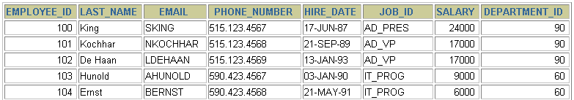
The NOT NULL Constraint
Ensures that null values are not permitted for the column:
…
NOT NULL constraint
(No row can contain a null value for this column.)
NOT NULL
constraint
Notes:
The NOT NULL Constraint
The NOT NULL constraint ensures that the column contains no null values. Columns without the NOT NULL constraint can contain null values by default.

Slide 23
The NOT NULL Constraint
Is defined at the column level:
CREATE TABLE employees(
employee_id NUMBER(6),
last_name VARCHAR2(25) NOT NULL,
salary NUMBER(8,2),
commission_pct NUMBER(2,2),
hire_date DATE CONSTRAINT emp_hiredate_nn NOT NULL
)
System
named
User named
Notes:
The NOT NULL Constraint (continued)
The NOT NULL constraint can be specified only at the column level, not at the table level.
The slide example applies the NOT NULL constraint to the LAST_NAME and HIRE_DATE columns of the EMPLOYEES table. Because these constraints are unnamed, the Oracle server creates names for them.
You can specify the name of the constraint when you specify the constraint:
... last_name VARCHAR2(25)
CONSTRAINT emp_last_name_nn NOT NULL...
Note: The constraint examples described in this lesson may not be present in the sample tables provided with the course. If desired, these constraints can be added to the tables.

Slide 24
Viewing Constraints
Show all constraints defined by user on employees table
SELECT constraint_name, constraint_type,
search_condition
FROM user_constraints
WHERE table_name = 'EMPLOYEES';
Notes:
Viewing Constraints
After creating a table, you can confirm its existence by issuing a DESCRIBE command. The only constraint that you can verify is the NOT NULL constraint. To view all constraints on your table, query the USER_CONSTRAINTS table.
The example on the slide displays the constraints on the EMPLOYEES table.
Note: Constraints that are not named by the table owner receive the system-assigned constraint name. In constraint type, C stands for CHECK, P for PRIMARY KEY, R for referential integrity, and U for UNIQUE key. Notice that the NOT NULL constraint is really a CHECK constraint.
Instructor Note
Point out to students that the NOT NULL constraint is stored in the data dictionary as a CHECK constraint. Draw their attention to the constraint type, for the NOT NULL constraints in the slide. The entry in the constraint_type field is C (as in CHECK) for these constraints.

Slide 25
Viewing the Columns Associated with Constraints
Find the columns of employee table where constraints are applied.
SELECT constraint_name, column_name
FROM user_cons_columns
WHERE table_name = 'EMPLOYEES';
Notes:
Viewing Constraints (continued)
You can view the names of the columns involved in constraints by querying the USER_CONS_COLUMNS data dictionary view. This view is especially useful for constraints that use system-assigned names.

Slide 26
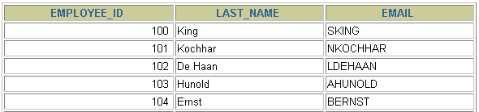
The UNIQUE Constraint
UNIQUE constraint
EMPLOYEES
…
INSERT INTO
Allowed
Not allowed: already exists
Notes:
The UNIQUE Constraint
A UNIQUE key integrity constraint requires that every value in a column or set of columns (key) be unique—that is, no two rows of a table can have duplicate values in a specified column or set of columns. The column (or set of columns) included in the definition of the UNIQUE key constraint is called the unique key. If the UNIQUE constraint comprises more than one column, that group of columns is called a composite unique key.
UNIQUE constraints allow the input of nulls unless you also define NOT NULL constraints for the same columns. In fact, any number of rows can include nulls for columns without NOT NULL constraints because nulls are not considered equal to anything. A null in a column (or in all columns of a composite UNIQUE key) always satisfies a UNIQUE constraint.
Note: Because of the search mechanism for UNIQUE constraints on more than one column, you cannot have identical values in the non-null columns of a partially null composite UNIQUE key constraint.
Instructor Note
Explain to students that since the JSMITH e-mail ID already exists after the first insertion, the second entry is not allowed.

Slide 27
The UNIQUE Constraint
Defined at either the table level or the column level:
CREATE TABLE employees(
employee_id NUMBER(6),
last_name VARCHAR2(25) NOT NULL,
email VARCHAR2(25),
salary NUMBER(8,2),
commission_pct NUMBER(2,2),
hire_date DATE NOT NULL,
...
CONSTRAINT emp_email_uk UNIQUE(email));
CREATE TABLE employees(
employee_id NUMBER(6),
last_name VARCHAR2(25) NOT NULL,
email VARCHAR2(25) UNIQUE,
...
);
Notes:
The UNIQUE Constraint (continued)
UNIQUE constraints can be defined at the column or table level. A composite unique key is created by using the table level definition.
The example on the slide applies the UNIQUE constraint to the EMAIL column of the EMPLOYEES table. The name of the constraint is EMP_EMAIL_UK..
Note: The Oracle server enforces the UNIQUE constraint by implicitly creating a unique index on the unique key column or columns.

Slide 28
The CHECK Constraint
Defines a condition that each row must satisfy
The following expressions are not allowed:
References to CURRVAL, NEXTVAL, LEVEL, and ROWNUM pseudocolumns
Calls to SYSDATE, UID, USER, and USERENV functions
Queries that refer to other values in other rows
..., salary NUMBER(2)
CONSTRAINT emp_salary_min
CHECK (salary > 0),...
Notes:
The CHECK Constraint
The CHECK constraint defines a condition that each row must satisfy. The condition can use the same constructs as query conditions, with the following exceptions:
References to the CURRVAL, NEXTVAL, LEVEL, and ROWNUM pseudocolumns
Calls to SYSDATE, UID, USER, and USERENV functions
Queries that refer to other values in other rows
A single column can have multiple CHECK constraints which refer to the column in its definition. There is no limit to the number of CHECK constraints which you can define on a column.
CHECK constraints can be defined at the column level or table level.
CREATE TABLE employees
(...
salary NUMBER(8,2) CONSTRAINT emp_salary_min
CHECK (salary > 0),
...
Instructor Note
Explain what pseudocolumns are. Pseudocolumns are not actual columns in a table but they behave like columns. For example, you can select values from a pseudocolumn. However, you cannot insert into, update, or delete from a pseudocolumn. Pseudocolumns can be used in SQL statements.

Slide 29
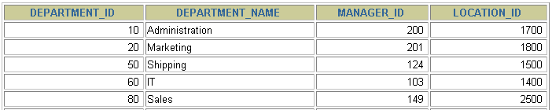
The PRIMARY KEY Constraint
DEPARTMENTS
PRIMARY KEY
…
Not allowed
(Null value)
INSERT INTO DEPARTMENTS
Not allowed (50 already exists)
Notes:
The PRIMARY KEY Constraint
A PRIMARY KEY constraint creates a primary key for the table. Only one primary key can be created for each table. The PRIMARY KEY constraint is a column or set of columns that uniquely identifies each row in a table. This constraint enforces uniqueness of the column or column combination and ensures that no column that is part of the primary key can contain a null value.

Slide 30
The PRIMARY KEY Constraint
Defined at table level
CREATE TABLE departments(
department_id NUMBER(4),
department_name VARCHAR2(30)
CONSTRAINT dept_name_nn NOT NULL,
manager_id NUMBER(6),
location_id NUMBER(4),
CONSTRAINT dept_id_pk PRIMARY KEY(department_id));
Defined at Column level
CREATE TABLE departments(
department_id NUMBER(4) PRIMARY KEY,
department_name VARCHAR2(30)
CONSTRAINT dept_name_nn NOT NULL,
manager_id NUMBER(6),
location_id NUMBER(4)
);
Notes:
The PRIMARY KEY Constraint (continued)
PRIMARY KEY constraints can be defined at the column level or table level. A composite PRIMARY KEY is created by using the table-level definition.
A table can have only one PRIMARY KEY constraint but can have several UNIQUE constraints.
The example on the slide defines a PRIMARY KEY constraint on the DEPARTMENT_ID column of the DEPARTMENTS table. The name of the constraint is DEPT_ID_PK.
Note: A UNIQUE index is automatically created for a PRIMARY KEY column.
Instructor Note
The example shown will not work in your schema because the DEPARTMENTS table already exists. To demonstrate this code, modify the name of the table within the script and then run the script.

Slide 31
The Composite PRIMARY KEY Constraint
Defined at table level
CREATE TABLE CourseRegistration(
Reg_No NUMBER(4),
Course_Code VARCHAR2(6),
Semester Number(1),
PRIMARY KEY(Reg_No, Course_Code)
);
Composite PRIMARY KEY
Defined at Column level
CREATE TABLE CourseRegistration(
Reg_No NUMBER(4) PRIMARY KEY,
Course_Code VARCHAR2(6) PRIMARY KEY,
Semester Number(1)
);
PRIMARY KEY
PRIMARY KEY
This table has two simple primary keys
Notes:
The PRIMARY KEY Constraint (continued)
PRIMARY KEY constraints can be defined at the column level or table level. A composite PRIMARY KEY is created by using the table-level definition.
A table can have only one PRIMARY KEY constraint but can have several UNIQUE constraints.
The example on the slide defines a PRIMARY KEY constraint on the DEPARTMENT_ID column of the DEPARTMENTS table. The name of the constraint is DEPT_ID_PK.
Note: A UNIQUE index is automatically created for a PRIMARY KEY column.
Instructor Note
The example shown will not work in your schema because the DEPARTMENTS table already exists. To demonstrate this code, modify the name of the table within the script and then run the script.

Slide 32
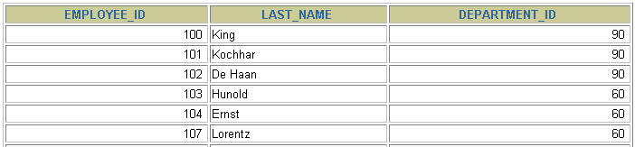
The FOREIGN KEY Constraint
DEPARTMENTS
PRIMARY KEY
…
EMPLOYEES
FOREIGN KEY
…
INSERT INTO
Not allowed (9 does not exist)
Allowed
Notes:
The FOREIGN KEY Constraint
The FOREIGN KEY, or referential integrity constraint, designates a column or combination of columns as a foreign key and establishes a relationship between a primary key or a unique key in the same table or a different table. In the example on the slide, DEPARTMENT_ID has been defined as the foreign key in the EMPLOYEES table (dependent or child table); it references the DEPARTMENT_ID column of the DEPARTMENTS table (the referenced or parent table).
A foreign key value must match an existing value in the parent table or be NULL.
Foreign keys are based on data values and are purely logical, not physical, pointers.
Instructor Note
Explain to students that you cannot create a foreign key without existing primary key values.

Slide 33
The FOREIGN KEY Constraint
Defined at column level:
CREATE TABLE employees(
employee_id NUMBER(6),
last_name VARCHAR2(25) NOT NULL,
department_id NUMBER(4)
REFERENCES departments);
Defined at table level:
CREATE TABLE employees(
employee_id NUMBER(6),
last_name VARCHAR2(25) NOT NULL,
department_id NUMBER(4),
CONSTRAINT emp_dept_fk FOREIGN KEY (department_id)
REFERENCES departments(department_id));
Notes:
The FOREIGN KEY Constraint (continued)
FOREIGN KEY constraints can be defined at the column or table constraint level. A composite foreign key must be created by using the table-level definition.
The example on the slide defines a FOREIGN KEY constraint on the DEPARTMENT_ID column of the EMPLOYEES table, using table-level syntax. The name of the constraint is EMP_DEPTID_FK.
The foreign key can also be defined at the column level, provided the constraint is based on a single column. The syntax differs in that the keywords FOREIGN KEY do not appear. For example:
CREATE TABLE employees
(...
department_id NUMBER(4) CONSTRAINT emp_deptid_fk
REFERENCES departments(department_id),
...
)

Slide 34
FOREIGN KEY Constraint Keywords
FOREIGN KEY: Defines the column in the child table at the table constraint level
REFERENCES: Identifies the table and column in the parent table
ON DELETE CASCADE: Deletes the dependent rows in the child table when a row in the parent table is deleted.
ON DELETE SET NULL: Converts dependent foreign key values to null
Notes:
The FOREIGN KEY Constraint (continued)
The foreign key is defined in the child table, and the table containing the referenced column is the parent table. The foreign key is defined using a combination of the following keywords:
FOREIGN KEY is used to define the column in the child table at the table constraint level.
REFERENCES identifies the table and column in the parent table.
ON DELETE CASCADE indicates that when the row in the parent table is deleted, the dependent rows in the child table will also be deleted.
ON DELETE SET NULL converts foreign key values to null when the parent value is removed.
The default behavior is called the restrict rule, which disallows the update or deletion of referenced data.
Without the ON DELETE CASCADE or the ON DELETE SET NULL options, the row in the parent table cannot be deleted if it is referenced in the child table.

Slide 35
The ALTER TABLE Statement
Use the ALTER TABLE statement to add, modify, or
drop columns.
ALTER TABLE table
ADD (column datatype [DEFAULT expr]
[, column datatype]...);
ALTER TABLE table
MODIFY (column datatype [DEFAULT expr]
[, column datatype]...);
ALTER TABLE table
DROP (column);
Notes:
The ALTER TABLE Statement (continued)
You can add, modify, and drop columns to a table by using the ALTER TABLE statement.
In the syntax:
table is the name of the table
ADD|MODIFY|DROP is the type of modification
column is the name of the new column
datatype is the data type and length of the new column
DEFAULT expr specifies the default value for a new column
Note: The slide gives the abridged syntax for ALTER TABLE. More about ALTER TABLE is covered in a subsequent lesson.
Instructor Note
In Oracle8i and later, there are new options for the ALTER TABLE command, including the ability to drop a column from a table, which are covered later in this lesson.

Slide 36
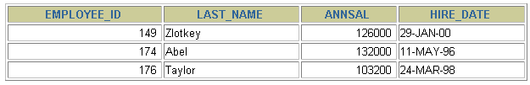

Adding a Column
DEPT
New column
“Add a new column to DEPT table.”
DEPT
Notes:
Adding a Column
The graphic adds the JOB_ID column to the DEPT80 table. Notice that the new column becomes the last column in the table.

Slide 37

Adding a Column
You use the ADD clause to add columns.
The new column becomes the last column.
ALTER TABLE dept
ADD (job_id VARCHAR2(9));
Table altered.
Notes:
Guidelines for Adding a Column
You can add or modify columns.
You cannot specify where the column is to appear. The new column becomes the last column.
The example on the slide adds a column named JOB_ID to the DEPT80 table. The JOB_ID column becomes the last column in the table.
Note: If a table already contains rows when a column is added, then the new column is initially null for all the rows.

Slide 38
Modifying a Column
You can change a column’s data type, size, and default value.
A change to the default value affects only subsequent insertions to the table.
ALTER TABLE dept
MODIFY (last_name VARCHAR2(30));
Table altered.
Notes:
Modifying a Column
You can modify a column definition by using the ALTER TABLE statement with the MODIFY clause. Column modification can include changes to a column’s data type, size, and default value.
Guidelines
You can increase the width or precision of a numeric column.
You can increase the width of numeric or character columns.
You can decrease the width of a column only if the column contains only null values or if the table has no rows.
You can change the data type only if the column contains null values.
You can convert a CHAR column to the VARCHAR2 data type or convert a VARCHAR2 column to the CHAR data type only if the column contains null values or if you do not change the size.
A change to the default value of a column affects only subsequent insertions to the table.

Slide 39
Dropping a Column
Use the DROP COLUMN clause to drop columns you no
longer need from the table.
ALTER TABLE dept
DROP COLUMN job_id;
Table altered.
Notes:
Dropping a Column
You can drop a column from a table by using the ALTER TABLE statement with the DROP COLUMN clause. This is a feature available in Oracle8i and later.
Guidelines
The column may or may not contain data.
Using the ALTER TABLE statement, only one column can be dropped at a time.
The table must have at least one column remaining in it after it is altered.
Once a column is dropped, it cannot be recovered.
Instructor Note
When a column is dropped from a table, any other columns in that table that are marked with the SET UNUSED option are dropped too.

Slide 40
Changing the Name of an Object
To change the name of a table, view, sequence, or synonym, you execute the RENAME statement.
You must be the owner of the object.
RENAME dept TO department;
Table renamed.
Notes:
Renaming a Table
Additional DDL statements include the RENAME statement, which is used to rename a table, view, sequence, or a synonym.
Syntax
RENAME old_name TO new_name;
In the syntax:
old_name is the old name of the table, view, sequence, or synonym.
new_name is the new name of the table, view, sequence, or synonym.
You must be the owner of the object that you rename.

Slide 41
Truncating a Table
The TRUNCATE TABLE statement:
Removes all rows from a table
Releases the storage space used by that table
You cannot roll back row removal when using TRUNCATE.
Alternatively, you can remove rows by using the DELETE statement.
DELETE FROM table-name;
TRUNCATE TABLE department;
Table truncated.
Notes:
Truncating a Table
Another DDL statement is the TRUNCATE TABLE statement, which is used to remove all rows from a table and to release the storage space used by that table. When using the TRUNCATE TABLE statement, you cannot roll back row removal.
Syntax
TRUNCATE TABLE table;
In the syntax:
table is the name of the table
You must be the owner of the table or have DELETE TABLE system privileges to truncate a table.
The DELETE statement can also remove all rows from a table, but it does not release storage space. The TRUNCATE command is faster. Removing rows with the TRUNCATE statement is faster than removing them with the DELETE statement for the following reasons:
The TRUNCATE statement is a data definition language (DDL) statement and generates no rollback information.
Truncating a table does not fire the delete triggers of the table.
If the table is the parent of a referential integrity constraint, you cannot truncate the table. Disable the constraint before issuing the TRUNCATE statement.

Slide 42
Adding a Constraint Syntax
Use the ALTER TABLE statement to:
Add or drop a constraint, but not modify its structure
Enable or disable constraints
Add a NOT NULL constraint by using the MODIFY clause
ALTER TABLE table
ADD [CONSTRAINT constraintName] type (column);
Notes:
Adding a Constraint
You can add a constraint for existing tables by using the ALTER TABLE statement with the ADD clause.
In the syntax:
table is the name of the table
constraint is the name of the constraint
type is the constraint type
column is the name of the column affected by the constraint
The constraint name syntax is optional, although recommended. If you do not name your constraints, the system will generate constraint names.
Guidelines
You can add, drop, enable, or disable a constraint, but you cannot modify its structure.
You can add a NOT NULL constraint to an existing column by using the MODIFY clause of the ALTER TABLE statement.
Note: You can define a NOT NULL column only if the table is empty or if the column has a value for every row.
Instructor Note
You can defer checking constraints for validity until the end of the transaction.
A constraint is deferred if the system checks that it is satisfied only on commit. If a deferred constraint is violated, then committing causes the transaction to roll back.
A constraint is immediate if it is checked at the end of each statement. If it is violated, the statement is rolled back immediately.

Slide 43
Adding a Constraint
Add a FOREIGN KEY constraint to the EMPLOYEES
table indicating that a manager must already exist as a valid employee in the EMPLOYEES table.
ALTER TABLE employees
ADD CONSTRAINT emp_manager_fk
FOREIGN KEY(manager_id)
REFERENCES employees(employee_id);
Table altered.
Notes:
Adding a Constraint (continued)
The example on the slide creates a FOREIGN KEY constraint on the EMPLOYEES table. The constraint ensures that a manager exists as a valid employee in the EMPLOYEES table.
Instructor Note
To add a NOT NULL constraint, use the ALTER TABLE MODIFY syntax:
ALTER TABLE employees
MODIFY (salary CONSTRAINT emp_salary_nn NOT NULL);

Slide 44
Dropping a Constraint
Remove the manager constraint from the EMPLOYEES table.
Remove the PRIMARY KEY constraint on the DEPARTMENTS table and drop the associated FOREIGN KEY constraint on the EMPLOYEES.DEPARTMENT_ID column.
ALTER TABLE employees
DROP CONSTRAINT emp_manager_fk;
Table altered.
ALTER TABLE departments
DROP PRIMARY KEY CASCADE;
Table altered.
Notes:
Dropping a Constraint
To drop a constraint, you can identify the constraint name from the USER_CONSTRAINTS and USER_CONS_COLUMNS data dictionary views. Then use the ALTER TABLE statement with the DROP clause. The CASCADE option of the DROP clause causes any dependent constraints also to be dropped.
Syntax
ALTER TABLE table
DROP PRIMARY KEY | UNIQUE (column) |
CONSTRAINT constraint [CASCADE];
In the syntax:
table is the name of the table
column is the name of the column affected by the constraint
constraint is the name of the constraint
When you drop an integrity constraint, that constraint is no longer enforced by the Oracle server and is no longer available in the data dictionary.

Slide 45
Disabling Constraints
Execute the DISABLE clause of the ALTER TABLE statement to deactivate an integrity constraint.
Apply the CASCADE option to disable dependent integrity constraints.
ALTER TABLE employees
DISABLE CONSTRAINT emp_emp_id_pk CASCADE;
Table altered.
Notes:
Disabling a Constraint
You can disable a constraint without dropping it or re-creating it by using the ALTER TABLE statement with the DISABLE clause.
Syntax
ALTER TABLE table
DISABLE CONSTRAINT constraint [CASCADE];
In the syntax:
table is the name of the table
constraint is the name of the constraint
Guidelines
You can use the DISABLE clause in both the CREATE TABLE statement and the ALTER TABLE statement.
The CASCADE clause disables dependent integrity constraints.
Disabling a unique or primary key constraint removes the unique index.

Slide 46
Enabling Constraints
Activate an integrity constraint currently disabled in the table definition by using the ENABLE clause.
A UNIQUE or PRIMARY KEY index is automatically created if you enable a UNIQUE key or PRIMARY KEY constraint.
ALTER TABLE employees
ENABLE CONSTRAINT emp_emp_id_pk;
Table altered.
Notes:
Enabling a Constraint
You can enable a constraint without dropping it or re-creating it by using the ALTER TABLE statement with the ENABLE clause.
Syntax
ALTER TABLE table
ENABLE CONSTRAINT constraint;
In the syntax:
table is the name of the table
constraint is the name of the constraint
Guidelines
If you enable a constraint, that constraint applies to all the data in the table. All the data in the table must fit the constraint.
If you enable a UNIQUE key or PRIMARY KEY constraint, a UNIQUE or PRIMARY KEY index is created automatically.
You can use the ENABLE clause in both the CREATE TABLE statement and the ALTER TABLE statement.
Enabling a primary key constraint that was disabled with the CASCADE option does not enable any foreign keys that are dependent upon the primary key.
Instructor Note
Please read the Instructor Note on page 10-29 for information on the VALIDATE and NOVALIDATE options.

Slide 47
Cascading Constraints
The CASCADE CONSTRAINTS clause is used along with the DROP COLUMN clause.
The CASCADE CONSTRAINTS clause drops all referential integrity constraints that refer to the primary and unique keys defined on the dropped columns.
The CASCADE CONSTRAINTS clause also drops all multicolumn constraints defined on the dropped columns.
Notes:
Cascading Constraints
This statement illustrates the usage of the CASCADE CONSTRAINTS clause. Assume table TEST1 is created as follows:
CREATE TABLE test1 (
pk NUMBER PRIMARY KEY,
fk NUMBER,
col1 NUMBER,
col2 NUMBER,
CONSTRAINT fk_constraint FOREIGN KEY (fk) REFERENCES test1,
CONSTRAINT ck1 CHECK (pk > 0 and col1 > 0),
CONSTRAINT ck2 CHECK (col2 > 0));
An error is returned for the following statements:
ALTER TABLE test1 DROP (pk); -- pk is a parent key
ALTER TABLE test1 DROP (col1); -- col1 is referenced by multicolumn constraint ck1

Slide 48
Cascading Constraints
Example:
ALTER TABLE test1
DROP (pk) CASCADE CONSTRAINTS;
Table altered.
ALTER TABLE test1
DROP (pk, fk, col1) CASCADE CONSTRAINTS;
Table altered.
Notes:
Cascading Constraints (continued)
Submitting the following statement drops column PK, the primary key constraint, the fk_constraint foreign key constraint, and the check constraint, CK1:
ALTER TABLE test1 DROP (pk) CASCADE CONSTRAINTS;
If all columns referenced by the constraints defined on the dropped columns are also dropped, then CASCADE CONSTRAINTS is not required. For example, assuming that no other referential constraints from other tables refer to column PK, it is valid to submit the following statement without the CASCADE CONSTRAINTS clause:
ALTER TABLE test1 DROP (pk, fk, col1);
Instructor Note
Let the students know that if any constraint is referenced by columns from other tables or remaining columns in the target table, then you must specify CASCADE CONSTRAINTS. Otherwise, the statement aborts and the error ORA-12991: column is referenced in a multicolumn constraint is returned.

Slide 49
Capabilities of SQL SELECT statement
Projection
Selection
Table 1
Table 1
Join
Table 1
Table 2

Slide 50
Guidelines for writing SQL
SQL statements are not case sensitive.
SQL statements can be on one or more lines.
Keywords cannot be abbreviated or split across lines.
Clauses are usually placed on separate lines.
Indents are used to enhance readability.

Slide 51
Basic SELECT statement
Syntax
SELECT identifies which columns
FROM identifies which table
SELECT *|{[DISTINCT] column|expression [alias],...}
FROM table;

Slide 52
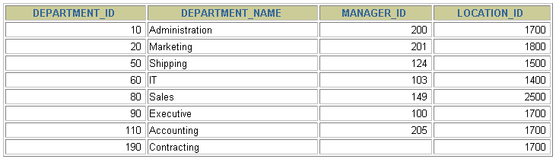
Selecting all columns
SELECT *
FROM departments;

Slide 53
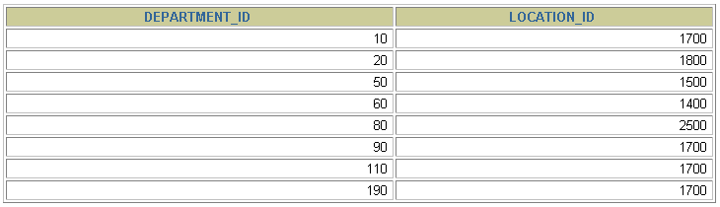
Selecting specific columns
SELECT department_id, location_id
FROM departments;

Slide 54
Defining a column alias
A column alias:
Renames a column heading
Is useful with calculations
Immediately follows the column name - there can also be the optional AS keyword between the column name and alias
Requires double quotation marks if it contains spaces or special characters or is case sensitive

Slide 55


Using column aliases
SELECT last_name AS name, commission_pct comm
FROM employees;
…
SELECT last_name "Name", salary*12 "Annual Salary"
FROM employees;
…

Slide 56
Concatenation operator
A concatenation operator:
Concatenates columns or character strings to other columns
Is represented by two vertical bars (||)
Creates a resultant column that is a character expression

Slide 57
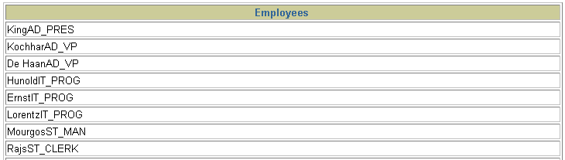
Using concatenation operator
SELECT last_name||job_id AS "Employees"
FROM employees;
…

Slide 58
Literal character strings
A literal is a character, a number, or a date included in the SELECT list.
Date and character literal values must be enclosed within single quotation marks.
Each character string is output once for each row returned.

Slide 59
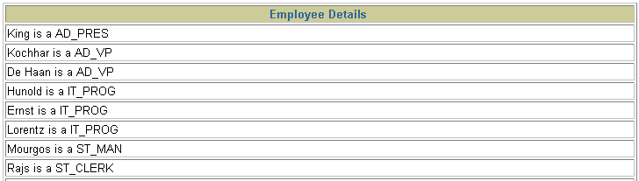
Using literal character strings
SELECT last_name ||' is a '||job_id
AS "Employee Details"
FROM employees;
…

Slide 60
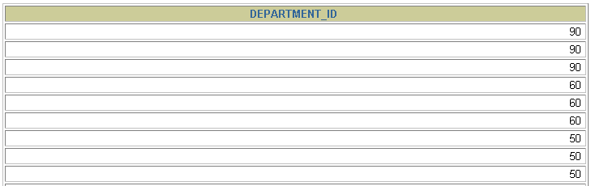
Duplicate rows
The default display of queries is all rows, including duplicate rows.
SELECT department_id
FROM employees;
…

Slide 61
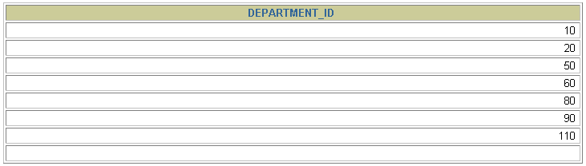
Eliminating duplicate rows
Eliminate duplicate rows by using the DISTINCT keyword in the SELECT clause.
SELECT DISTINCT department_id
FROM employees;

Slide 62
Arithmetic Expressions
Create expressions with number and date data by using arithmetic operators.
Operator
+
-
*
/
Description
Add
Subtract
Multiply
Divide

Slide 63
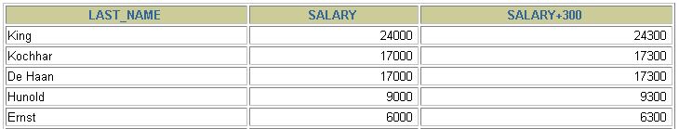

Using arithmetic operators
SELECT last_name, salary, salary + 300
FROM employees;
…

Slide 64
Operators precedence
* / + -
Multiplication and division take priority over addition and subtraction.
Operators of the same priority are evaluated from left to right.
Parentheses are used to force prioritized evaluation and to clarify statements.

Slide 65
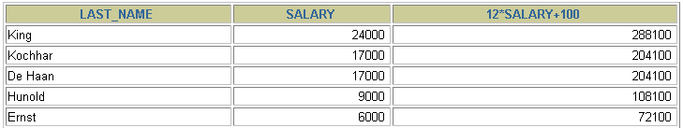

Operator precedence
SELECT last_name, salary, 12*salary+100
FROM employees;
…

Slide 66
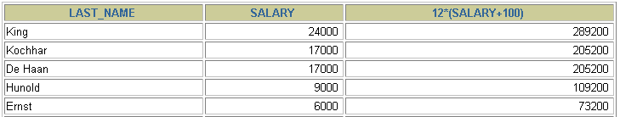

Using parenthesis
SELECT last_name, salary, 12*(salary+100)
FROM employees;
…

Slide 67
Defining a NULL value
A null is a value that is unavailable, unassigned, unknown, or inapplicable.
A null is not the same as zero or a blank space.
SELECT last_name, job_id, salary, commission_pct
FROM employees;
…
…

Slide 68
NULL values in Arithmetic Expressions
Arithmetic expressions containing a null value evaluate to null.
SELECT last_name, 12*salary*commission_pct
FROM employees;
…

Slide 69
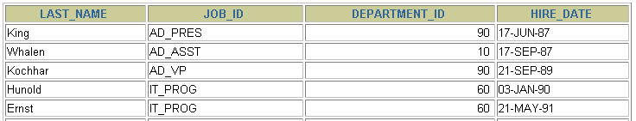
Sorting Rows
Sort rows with the ORDER BY clause
ASC: ascending order, default
DESC: descending order
The ORDER BY clause comes last in the SELECT statement.
SELECT last_name, job_id, department_id, hire_date
FROM employees
ORDER BY hire_date ;
…

Slide 70
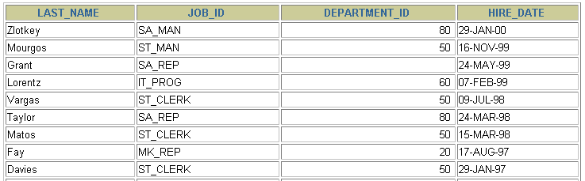
Sorting in Descending Order
SELECT last_name, job_id, department_id, hire_date
FROM employees
ORDER BY hire_date DESC ;
…

Slide 71
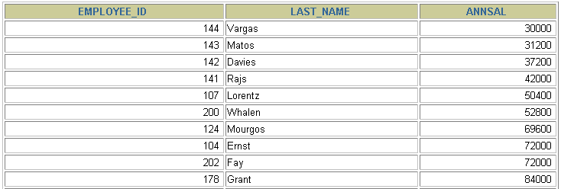
Sorting by Column Alias
SELECT employee_id, last_name, salary*12 annsal
FROM employees
ORDER BY annsal;
…

Slide 72
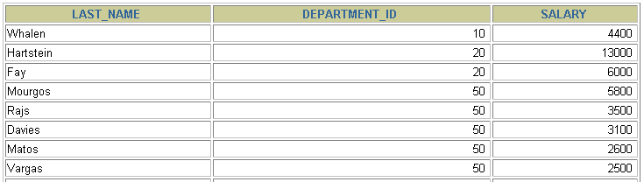
Sorting by Multiple Columns
The order of ORDER BY list is the order of sort.
You can sort by a column that is not in the SELECT list.
SELECT last_name, department_id, salary
FROM employees
ORDER BY department_id, salary DESC;
…

Slide 73
Outline
In this lecture, you will learn:
SQL SELECT
Row Filtering
Operators
Comparison operators
String & Set operators
Logical operators

Slide 74
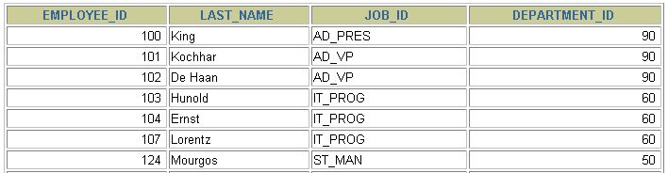

Limiting Rows Using a Selection
EMPLOYEES
…
“retrieve all employees in department 90”

Slide 75
Limiting the Rows Selected
Restrict the rows returned by using the WHERE clause.
The WHERE clause follows the FROM clause.
SELECT *|{[DISTINCT] column|expression [alias],...}
FROM table
[WHERE condition(s)];

Slide 76

Using the WHERE Clause
SELECT employee_id, last_name, job_id, department_id
FROM employees
WHERE department_id = 90 ;

Slide 77
Character Strings and Dates
Character strings and date values are enclosed in single quotation marks.
Character values are case sensitive, and date values are format sensitive.
The default date format is DD-MON-RR.
SELECT last_name, job_id, department_id
FROM employees
WHERE last_name = 'Whalen';

Slide 78
Comparison Conditions
Operator
=
>
>=
<
<=
<>
Meaning
Equal to
Greater than
Greater than or equal to
Less than
Less than or equal to
Not equal to

Slide 79

Using Comparison Conditions
SELECT last_name, salary
FROM employees
WHERE salary <= 3000;

Slide 80
Other Comparison Conditions
Operator
BETWEEN ...AND...
IN(set)
LIKE
IS NULL
Meaning
Between two values (inclusive),
Match any of a list of values
Match a character pattern
Is a null value

Slide 81
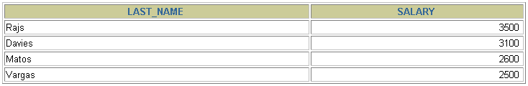
Using the BETWEEN Condition
Use the BETWEEN condition to display rows based on a range of values.
SELECT last_name, salary
FROM employees
WHERE salary BETWEEN 2500 AND 3500;
Lower limit
Upper limit

Slide 82
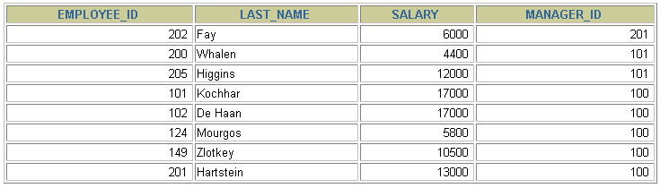
Using the IN Condition
Use the IN membership condition to test for values in
a list.
SELECT employee_id, last_name, salary, manager_id
FROM employees
WHERE manager_id IN (100, 101, 201);

Slide 83
Using the LIKE Condition
Use the LIKE condition to perform wildcard searches of valid search string values.
Search conditions can contain either literal characters or numbers:
% denotes zero or many characters.
_ denotes one character.
SELECT first_name
FROM employees
WHERE first_name LIKE 'S%';

Slide 84

Using the LIKE Condition
You can combine pattern-matching characters.
You can use the ESCAPE identifier to search for the actual % and _ symbols.
SELECT last_name
FROM employees
WHERE last_name LIKE '_o%';

Slide 85
Using the NULL Conditions
Test for nulls with the IS NULL operator.
SELECT last_name, manager_id
FROM employees
WHERE manager_id IS NULL;

Slide 86
Logical Conditions
Operator
AND OR
NOT
Meaning
Returns TRUE if both component conditions are true
Returns TRUE if either component condition is true
Returns TRUE if the following condition is false

Slide 87

Using the AND Operator
AND requires both conditions to be true.
SELECT employee_id, last_name, job_id, salary
FROM employees
WHERE salary >=10000
AND job_id LIKE '%MAN%';

Slide 88
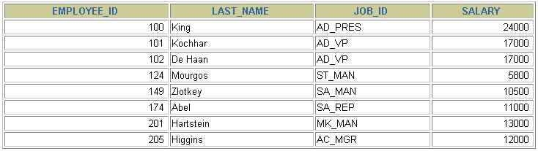
Using the OR Operator
OR requires either conditions to be true.
SELECT employee_id, last_name, job_id, salary
FROM employees
WHERE salary >= 10000
OR job_id LIKE '%MAN%';

Slide 89
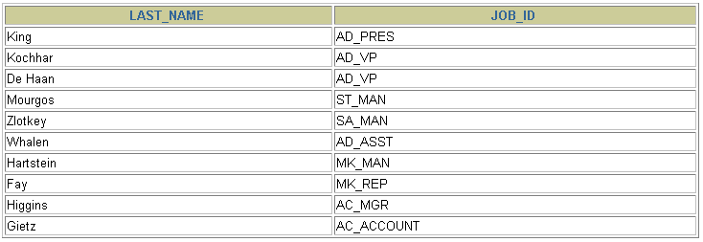
Using the NOT Operator
SELECT last_name, job_id
FROM employees
WHERE job_id
NOT IN ('IT_PROG', 'ST_CLERK', 'SA_REP');

Slide 90
Rules of Precedence
Order Evaluated Operator
1 Arithmetic operators
2 Concatenation operator
3 Comparison conditions
4 IS [NOT] NULL, LIKE, [NOT] IN
5 [NOT] BETWEEN
6 NOT logical condition
7 AND logical condition
8 OR logical condition
Override rules of precedence by using parentheses.

Slide 91
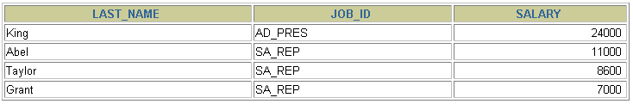
Rules of Precedence
SELECT last_name, job_id, salary
FROM employees
WHERE job_id = 'SA_REP'
OR job_id = 'AD_PRES'
AND salary > 15000;

Slide 92
Using parenthesis
Use parenthesis to force priority
SELECT last_name, job_id, salary
FROM employees
WHERE (job_id = 'SA_REP'
OR job_id = 'AD_PRES')
AND salary > 15000;

Slide 93
Data Manipulation Language
A DML statement is executed when you:
Add new row(s) to a table
INSERT
Get row(s) from table
SELECT
Modify existing rows in a table
UPDATE
Remove existing rows from a table
DELETE
Notes:
Data Manipulation Language
Data manipulation language (DML) is a core part of SQL. When you want to add, update, or delete data in the database, you execute a DML statement. A collection of DML statements that form a logical unit of work is called a transaction.
Consider a banking database. When a bank customer transfers money from a savings account to a checking account, the transaction might consist of three separate operations: decrease the savings account, increase the checking account, and record the transaction in the transaction journal. The Oracle server must guarantee that all three SQL statements are performed to maintain the accounts in proper balance. When something prevents one of the statements in the transaction from executing, the other statements of the transaction must be undone.
Instructor Note
DML statements can be issued directly in iSQL*Plus, performed automatically by tools such as Oracle Forms Services, or programmed with tools such as the 3GL precompilers.
Every table has INSERT, UPDATE, and DELETE privileges associated with it. These privileges are automatically granted to the creator of the table, but in general they must be explicitly granted to other users.
Starting with Oracle 7.2, you can place a subquery in the place of the table name in an UPDATE statement, essentially the same way you use a view.

Slide 94
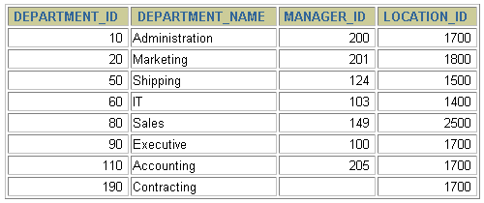
Adding a New Row to a Table
New
row
DEPARTMENTS
…insert a new row into the DEPARMENTS table…
Notes:
Adding a New Row to a Table
The slide graphic illustrates adding a new department to the DEPARTMENTS table.

Slide 95
The INSERT Statement Syntax
Add new rows to a table by using the INSERT statement.
Only one row is inserted at a time with this syntax.
INSERT INTO table [(column [, column...])]
VALUES (value [, value...]);
Notes:
Adding a New Row to a Table (continued)
You can add new rows to a table by issuing the INSERT statement.
In the syntax:
table is the name of the table
column is the name of the column in the table to populate
value is the corresponding value for the column
Note: This statement with the VALUES clause adds only one row at a time to a table.

Slide 96
Inserting New Rows
Insert a new row containing values for each column.
List values in the default order of the columns in the table.
Optionally, list the columns in the INSERT clause.
Enclose character and date values within single quotation marks.
INSERT INTO departments(department_id, department_name,
manager_id, location_id)
VALUES (70, 'Public Relations', 100, 1700);
1 row created.
Notes:
Adding a New Row to a Table (continued)
Because you can insert a new row that contains values for each column, the column list is not required in the INSERT clause. However, if you do not use the column list, the values must be listed according to the default order of the columns in the table, and a value must be provided for each column.
DESCRIBE departments
For clarity, use the column list in the INSERT clause. Enclose character and date values within single quotation marks; it is not recommended to enclose numeric values within single quotation marks.
Number values should not be enclosed in single quotes, because implicit conversion may take place for numeric values assigned to NUMBER data type columns if single quotes are included.

Slide 97
Inserting Rows with Null Values
Implicit method: Omit the column from the column list.
INSERT INTO departments (department_id,
department_name )
VALUES (30, 'Purchasing');
1 row created.
Explicit method: Specify the NULL keyword in the VALUES clause.
INSERT INTO departments
VALUES (100, 'Finance', NULL, NULL);
1 row created.
Notes:
Methods for Inserting Null Values
Be sure that you can use null values in the targeted column by verifying the Null? status with the iSQL*Plus DESCRIBE command.
The Oracle Server automatically enforces all data types, data ranges, and data integrity constraints. Any column that is not listed explicitly obtains a null value in the new row.
Common errors that can occur during user input:
Mandatory value missing for a NOT NULL column
Duplicate value violates uniqueness constraint
Foreign key constraint violated
CHECK constraint violated
Data type mismatch
Value too wide to fit in column

Slide 98
Inserting Special Values
The SYSDATE function records the current date and time.
INSERT INTO employees (employee_id,
first_name, last_name,
email, phone_number,
hire_date, job_id, salary,
commission_pct, manager_id,
department_id)
VALUES (113,
'Louis', 'Popp',
'LPOPP@gmail.com', '515.124.4567',
SYSDATE, 'AC_ACCOUNT', 6900,
NULL, 205, 100);
1 row created.
Notes:
Inserting Special Values by Using SQL Functions
You can use functions to enter special values in your table.
The slide example records information for employee Popp in the EMPLOYEES table. It supplies the current date and time in the HIRE_DATE column. It uses the SYSDATE function for current date and time.
You can also use the USER function when inserting rows in a table. The USER function records the current username.
Confirming Additions to the Table
SELECT employee_id, last_name, job_id, hire_date, commission_pct
FROM employees
WHERE employee_id = 113;

Slide 99
Inserting Specific Date Values
Add a new employee.
Verify your addition.
INSERT INTO employees
VALUES (114,
'Den', 'Raphealy',
'DRAPHEAL', '515.127.4561',
TO_DATE('FEB 3, 1999', 'MON DD, YYYY'),
'AC_ACCOUNT', 11000, NULL, 100, 30);
1 row created.
Notes:
Inserting Specific Date and Time Values
The DD-MON-YY format is usually used to insert a date value. With this format, recall that the century defaults to the current century. Because the date also contains time information, the default time is midnight (00:00:00).
If a date must be entered in a format other than the default format, for example, with another century, or a specific time, you must use the TO_DATE function.
The example on the slide records information for employee Raphealy in the EMPLOYEES table. It sets the HIRE_DATE column to be February 3, 1999. If you use the following statement instead of the one shown on the slide, the year of the hire_date is interpreted as 2099.
INSERT INTO employees
VALUES (114,
'Den', 'Raphealy',
'DRAPHEAL', '515.127.4561',
'03-FEB-99',
'AC_ACCOUNT', 11000, NULL, 100, 30);
If the RR format is used, the system provides the correct century automatically, even if it is not the current one.
Instructor Note
The default date format in Oracle9i is DD-MON-RR. Prior to release 8.16, the default format was DD-MON-YY.

Slide 100
Copying Rows from Another Table
Write your INSERT statement with a subquery.
Do not use the VALUES clause.
It copies all data from employees table into emp table
INSERT INTO emp
SELECT * FROM employees;
4 rows created.
Notes:
Copying Rows from Another Table
You can use the INSERT statement to add rows to a table where the values are derived from existing tables. In place of the VALUES clause, you use a subquery.
Syntax
INSERT INTO table [ column (, column) ] subquery;
In the syntax:
table is the table name
column is the name of the column in the table to populate
subquery is the subquery that returns rows into the table
The number of columns and their data types in the column list of the INSERT clause must match the number of values and their data types in the subquery. To create a copy of the rows of a table, use SELECT * in the subquery.
INSERT INTO copy_emp
SELECT *
FROM employees;
For more information, see Oracle9i SQL Reference, “SELECT,” subqueries section.
Instructor Note
Please run the script 8_cretabs.sql to create the COPY_EMP and SALES_REPS tables before demonstrating the code examples. Do not get into too many details on copying rows from another table.

Slide 101
Copying Specific Columns data from Another Table
INSERT INTO emp(id, name, salary)
SELECT employee_id, last_name, salary
FROM employees;
4 rows created.
Match the number of columns in the INSERT clause to those in the subquery.
Notes:
Copying Rows from Another Table
You can use the INSERT statement to add rows to a table where the values are derived from existing tables. In place of the VALUES clause, you use a subquery.
Syntax
INSERT INTO table [ column (, column) ] subquery;
In the syntax:
table is the table name
column is the name of the column in the table to populate
subquery is the subquery that returns rows into the table
The number of columns and their data types in the column list of the INSERT clause must match the number of values and their data types in the subquery. To create a copy of the rows of a table, use SELECT * in the subquery.
INSERT INTO copy_emp
SELECT *
FROM employees;
For more information, see Oracle9i SQL Reference, “SELECT,” subqueries section.
Instructor Note
Please run the script 8_cretabs.sql to create the COPY_EMP and SALES_REPS tables before demonstrating the code examples. Do not get into too many details on copying rows from another table.

Slide 102
Copying Specific Rows from Another Table
INSERT INTO emp_CS(id, name, salary)
SELECT employee_id, last_name, salary
FROM employees;
WHERE emp_dept = ‘CS’;
4 rows created.
You can filter rows before entering into new table
It first search out the CS employees and then insert its respective data (id, name, salary) into emp_CS table
Notes:
Copying Rows from Another Table
You can use the INSERT statement to add rows to a table where the values are derived from existing tables. In place of the VALUES clause, you use a subquery.
Syntax
INSERT INTO table [ column (, column) ] subquery;
In the syntax:
table is the table name
column is the name of the column in the table to populate
subquery is the subquery that returns rows into the table
The number of columns and their data types in the column list of the INSERT clause must match the number of values and their data types in the subquery. To create a copy of the rows of a table, use SELECT * in the subquery.
INSERT INTO copy_emp
SELECT *
FROM employees;
For more information, see Oracle9i SQL Reference, “SELECT,” subqueries section.
Instructor Note
Please run the script 8_cretabs.sql to create the COPY_EMP and SALES_REPS tables before demonstrating the code examples. Do not get into too many details on copying rows from another table.

Slide 103
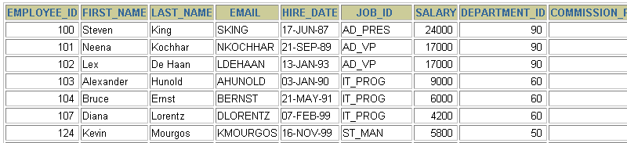
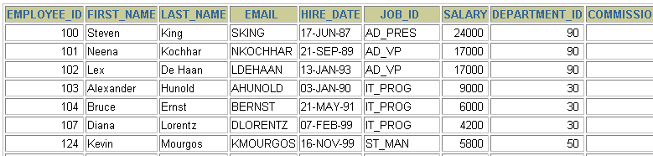
Changing Data in a Table
EMPLOYEES
Update rows in the EMPLOYEES table.
Notes:
Changing Data in a Table
The slide graphic illustrates changing the department number for employees in department 60 to department 30.

Slide 104
The UPDATE Statement Syntax
Modify existing rows with the UPDATE statement.
Update more than one row at a time, if required.
UPDATE table
SET column = value [, column = value, ...]
[WHERE condition];
Notes:
Updating Rows
You can modify existing rows by using the UPDATE statement.
In the syntax:
table is the name of the table
column is the name of the column in the table to populate
value is the corresponding value or subquery for the column
condition identifies the rows to be updated and is composed of column names expressions, constants, subqueries, and comparison operators
Confirm the update operation by querying the table to display the updated rows.
For more information, see Oracle9i SQL Reference, “UPDATE.”
Note: In general, use the primary key to identify a single row. Using other columns can unexpectedly cause several rows to be updated. For example, identifying a single row in the EMPLOYEES table by name is dangerous, because more than one employee may have the same name.

Slide 105
Updating Rows in a Table
Specific row or rows are modified if you specify the WHERE clause.
All rows in the table are modified if you omit the WHERE clause.
UPDATE employees
SET department_id = 70
WHERE employee_id = 113;
1 row updated.
UPDATE copy_emp
SET department_id = 110;
22 rows updated.
Notes:
Updating Rows (continued)
The UPDATE statement modifies specific rows if the WHERE clause is specified. The slide example transfers employee 113 (Popp) to department 70.
If you omit the WHERE clause, all the rows in the table are modified.
SELECT last_name, department_id
FROM copy_emp;
Note: The COPY_EMP table has the same data as the EMPLOYEES table.
…

Slide 106
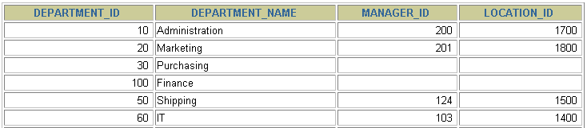
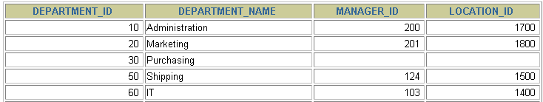
Removing a Row from a Table
DEPARTMENTS
Delete a row from the DEPARTMENTS table.
Notes:
Removing a Row from a Table
The slide graphic removes the Finance department from the DEPARTMENTS table (assuming that there are no constraints defined on the DEPARTMENTS table).
Instructor Note
After all the rows have been eliminated with the DELETE statement, only the data structure of the table remains. A more efficient method of emptying a table is with the TRUNCATE statement. You can use the TRUNCATE statement to quickly remove all rows from a table or cluster. Removing rows with the TRUNCATE statement is faster than removing them with the DELETE statement for the following reasons:
The TRUNCATE statement is a data definition language (DDL) statement and generates no rollback information. It is covered in a subsequent lesson.
Truncating a table does not fire the delete triggers of the table.
If the table is the parent of a referential integrity constraint, you cannot truncate the table. Disable the constraint before issuing the TRUNCATE statement.

Slide 107
The DELETE Statement
You can remove existing rows from a table by using
the DELETE statement.
DELETE [FROM] table
[WHERE condition];
Notes:
Deleting Rows
You can remove existing rows by using the DELETE statement.
In the syntax:
table is the table name condition identifies the rows to be deleted and is composed of column names, expressions, constants, subqueries, and comparison operators
Note: If no rows are deleted, a message “0 rows deleted.” is returned:
For more information, see Oracle9i SQL Reference, “DELETE.”
Instructor Note
The DELETE statement does not ask for confirmation. However, the delete operation is not made permanent until the data transaction is committed. Therefore, you can undo the operation with the ROLLBACK statement if you make a mistake.

Slide 108
Deleting Rows from a Table
Specific rows are deleted if you specify the WHERE clause.
All rows in the table are deleted if you omit the WHERE clause.
Deleting a specific row
DELETE FROM departments
WHERE department_name = 'Finance';
1 row deleted.
DELETE FROM copy_emp;
22 rows deleted.
DELETE FROM copy_emp where empno=10;
1 row deleted.
Notes:
Deleting Rows (continued)
You can delete specific rows by specifying the WHERE clause in the DELETE statement. The slide example deletes the Finance department from the DEPARTMENTS table. You can confirm the delete operation by displaying the deleted rows using the SELECT statement.
SELECT *
FROM departments
WHERE department_name = 'Finance';
no rows selected.
If you omit the WHERE clause, all rows in the table are deleted. The second example on the slide deletes all the rows from the COPY_EMP table, because no WHERE clause has been specified.
Example
Remove rows identified in the WHERE clause.
DELETE FROM employees
WHERE employee_id = 114;
1 row deleted.
DELETE FROM departments
WHERE department_id IN (30, 40);
2 rows deleted.

